Slide 1
CSSE3113 – Introduction to Software Engineering
Software Architectural Design

Slide 2
Software Architecture
“The architecture of a system is a comprehensive framework that describes its form and structure – its components and how they fit together.”
Jerrold Grochow

Slide 3
Architectural Design
Architectural design is concerned with understanding how a system should be organized and designing the overall structure of that system.
It is the first stage in the software design process.
Architectural design is a creative process where you design a system organization that will satisfy the functional and non-functional requirements of a system.

Slide 4
Architectural Design
These requirements include performance, security, availability, and maintainability. …
Performance: Performance can be enhanced by localizing operations to minimise sub-system communication. That is, try to have self-contained modules as much as possible so that inter-module communication is minimized.
Security: Security can be improved by using a layered architecture with critical assets put in inner layers.

Slide 5
Architectural Design
Availability: building redundancy in the system and having redundant components in the architecture can ensure Availability.
Maintainability: Maintainability is directly related with simplicity. Therefore, using fine-grain, self-contained components can increase maintainability.

Slide 6
Architectural Design Process
System structuring: System structuring is concerned with decomposing the system into interacting sub-systems.
Control modeling: Control modelling establishes a model of the control relationships between the different parts of the system.
Modular decomposition: During this activity, the identified sub-systems are decomposed into modules.

Slide 7
Block Diagrams
Block diagrams are often used to describe sub-system designs
Each box in the diagram represents a sub-system.
Boxes within boxes indicate that the sub-system has itself been decomposed to sub-systems.
Arrows mean that data and or control signals are passed from sub-system to sub-system in the direction of the arrows.
Block diagrams present a high-level picture of the system structure,

Slide 8
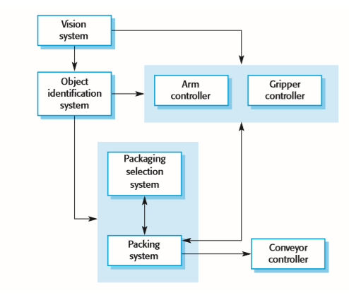
Block diagram of a packing robot control system

Slide 9
Architectural Styles
Among many styles, the most commonly practiced ones are the following:
Pipe & Filters Architecture
Client Server Architecture
Layered Architecture
Model View Controller (MVC)
Data-Centered and Repository Architecture

Slide 10
Pipe and Filters Architecture
It is a data flow architecture
Data flow consider the system a series of transformation on set of data
Data is transformed from one form to another using different types of operations
The pipe-filter architecture has an independent entity call filer (which is responsible to perform operations)

Slide 11
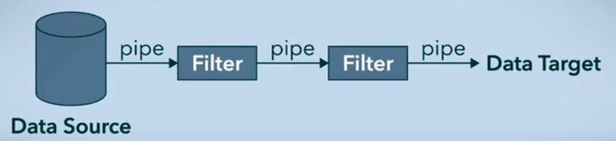
Pipe and Filter Architecture
Filter perform operations on data input they received
Pipes are service connectors through which data is being transformed
Data is changed filter to filter
In this architecture, order of the filter might effect the results.

Slide 12
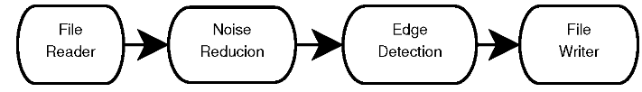
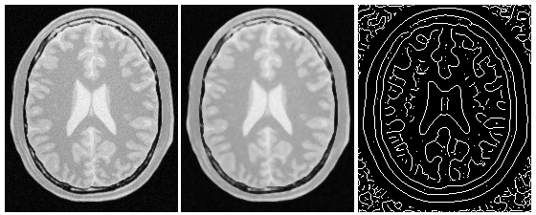
Pipe and Filters Architecture - Example
The output of one filter becomes the input to the others
Example

Slide 13
Pipe and Filters Architecture
Advantages:
Loose coupling allows filters to be changed without modifications to other filters
Can be develop with parallel processing.
Disadvantages:
Not a good choice for an interactive system
Addition of a large number of independent filters may reduce performance due to excessive computational overheads

Slide 14
Client/Server Model
The client-server model is a distributed system model that shows how data and processing is distributed across a range of components.
The functionality of the system is organized into services, with each service delivered from a separate server.
Clients are users of these services and access servers to make use of them.
In this model, the application is modeled as
A set of services that are provided by servers
A set of clients that use these services.

Slide 15
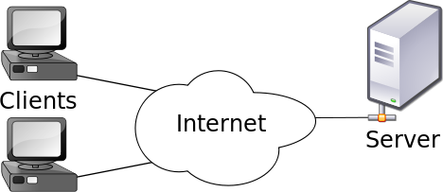
Client/Server Model

Slide 16
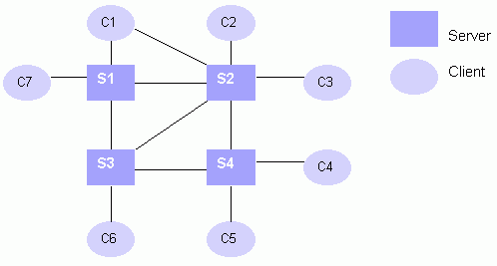
Client/Server Model
General client-server organization

Slide 17
Client/Server Model
Following are some of the representative server types in client-server systems:
Database servers: In this case, the client sends requests, such as SQL queries, to the database server; the server processes the request and returns the results to the client over the network.

Slide 18
Client/Server Model
Transaction servers: In this configuration, client sends requests that invoke remote procedures on the server side; server executes procedures invoked and returns the results to the client.
Groupware servers: Groupware servers provide set of applications that enable communication among clients using text, images and video, etc.

Slide 19
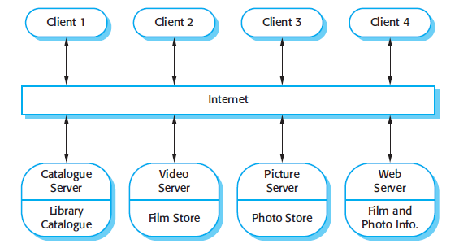
A Client–Server Architecture for a Film Library

Slide 20
Client/Server Model
Advantages:
Adding new servers or upgrading existing servers becomes easier.
Distribution of data is straightforward in this case.
Disadvantages:
Each service is a single point of failure so susceptible to denial of service attacks or server failure.
Performance may be unpredictable because it depends on the network.

Slide 21
Layered Architecture
A layered architecture organizes a system into a set of layers each of which provide a set of services to the layer “above”and serving as client to the layer “below”.
Inner layers are closer to the machine hardware than the outer layers and each layer isolates the outer layer from inner complexities
Supports incremental development

Slide 22
Layered Architecture
The outer layer only needs to know the interface provided by the inner layer
If there are any changes in the inner layer, the outer layer is not affected as long as the interface does not change
The layered architecture pattern is another way of achieving separation and independence.

Slide 23
Advantages
Independence
Different components of the application can be independently deployed, maintained, and updated, on different time schedules
Makes possible for team members to work in parallel on different parts of the application with minimal dependencies.
Testing the components independently of each other.

Slide 24
Advantages
More secure
Each layer may hide private information from other layers
Reusability
Each layer, being cohesive and is coupled only to lower layers, makes it easier for reuse by others and easier to be replaced or interchanged

Slide 25
Disadvantages
Performance degrades if we have too many layers (extra overhead of passing through layers and also changes will pass slowly to higher layers )
Sometimes difficult to cleanly assign functionality to the “right” layer

Slide 26
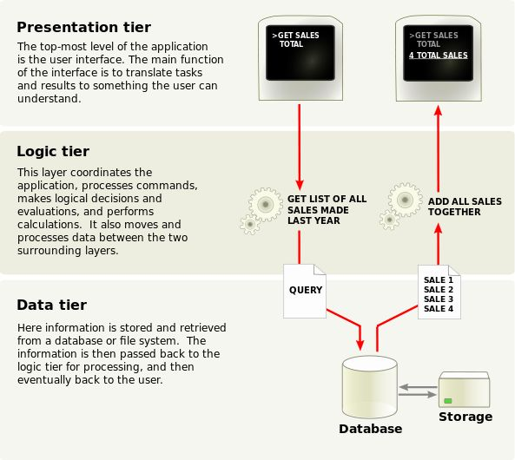
Layered Architecture

Slide 27
Model View Controller
The purpose is to decompose the application into multiple components, where every component has its own purpose
It divide the application into three main components:
Model
View
Controller

Slide 28
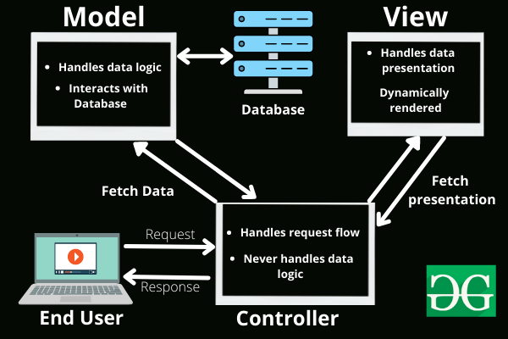
Model View Controller
This is done to separate internal representations of information from the ways information is presented to and accepted from the user.
Popular examples of MVC frameworks:
Ruby on Rails.
Django
CakePHP

Slide 29
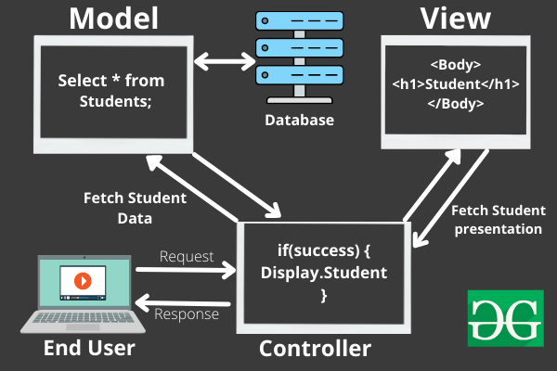
Example:

Slide 30
Advantages and Disadvantages
Advantages:
Separation of concern
Easy to maintain
MVC model returns data without formatting, so it is useful for multiple types of devices (mobile and desktop)
Disadvantages:
It can’t be suitable for small applications which has adverse effect in the application's performance and design

Slide 31
Data-Centered or Repository Architecture
In any system, sub-systems need to exchange information and data. This may be done in two ways:
Shared data is held in a central database or repository and may be accessed by all sub-systems
Each sub-system maintains its own database and passes data to other sub-systems
When large amounts of data are to be shared, the repository model of sharing is most commonly used.

Slide 32
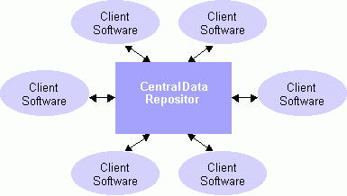
Data-Centered or Repository Architecture

Slide 33
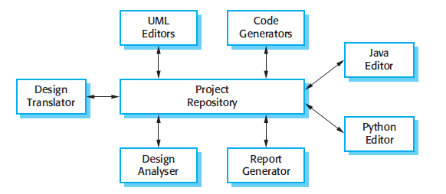
A Repository Architecture for an IDE

Slide 34
Data-Centered or Repository Architecture
Advantages
An efficient way to share large amounts of data.
The sub-systems need not be concerned with how data is produced and the centralized management e.g. backup, security, etc.
Disadvantages
The repository is a single point of failure so problems in the repository affect the whole system.

